Slide 1
IMAGE RESTORATION AND IMAGE ENHANCEMENT USING IMAGE PROCESSING TOOLS
PROJECT
STUDENT NAME : PADALA SAI BAP REDDY
DEPARTMENT:CSE[AIML]
SUBJECT:DIGITAL IMAGE PROCESSING

Slide 2
CONTENT
Problem Statement
Technology used
Wow factor
End users
Result
Conclusion
Git-hub Link
Future scope

Slide 3
PROBLEM STATEMENT
The project focuses on developing advanced image processing techniques for image enhancement and image restoration using state-of-the-art tools. Image enhancement aims to improve visual quality by adjusting brightness, contrast, sharpness, and reducing noise, making images more appealing or suitable for specific applications. Image restoration involves reconstructing or recovering degraded images affected by factors like blur, noise, or missing data, ensuring the output resembles the original scene accurately. The objective is to design and implement algorithms that address these challenges efficiently, catering to real-world scenarios such as medical imaging, satellite imagery, and digital photography.

Slide 4
TECHNOLOGY USED
Programming Languages:
Python: Widely used for its extensive libraries and frameworks.
MATLAB: Popular for image processing and algorithm development.
Libraries and Frameworks:
OpenCV: A powerful library for computer vision and image processing tasks.
TensorFlow and PyTorch: For implementing deep learning models for image restoration and enhancement.
scikit-image: A Python library for image processing.
NumPy and SciPy: For numerical computations and image manipulation.
Platforms:
Google Colab: For running Python code in the cloud with GPU support.
Jupyter Notebooks: For interactive development and visualization.

Slide 5
WOW FACTORS
Real-World Impact: The ability to restore degraded images and enhance visual quality is highly beneficial in fields like medical imaging, surveillance, and space exploration.
AI and Machine Learning Integration: Incorporating advanced algorithms can demonstrate cutting-edge technology in action, showcasing innovation.
Cross-Disciplinary Applications: The project finds relevance in diverse industries such as photography, heritage conservation, and forensics, highlighting its versatility.
Improving Accessibility: Enhancing images can aid visually impaired individuals by making content more perceivable.
Creative Transformations: Turning old, damaged, or low-quality images into vibrant and high-resolution outputs captures a sense of magic and artistry.
Broad Appeal: From professionals to casual users, the outcomes resonate with a wide audience, making it both impactful and relatable.

Slide 6
END USERS
Photographers: Professionals seeking to improve the quality of their photos or restore old ones.
Artists and Designers: Individuals creating visuals for art, media, or branding purposes.
Healthcare Professionals: Doctors and radiologists using enhanced medical imaging for better diagnosis and treatment.
Archaeologists and Historians: Experts restoring historical images and documents for research and preservation.
Government and Law Enforcement: Using restored images for surveillance or forensic analysis.
Everyday Users: People enhancing personal photos or restoring cherished memories.

Slide 7
INPUT
IMAGE RESTORATION
IMAGE ENHANCEMENT

Slide 8
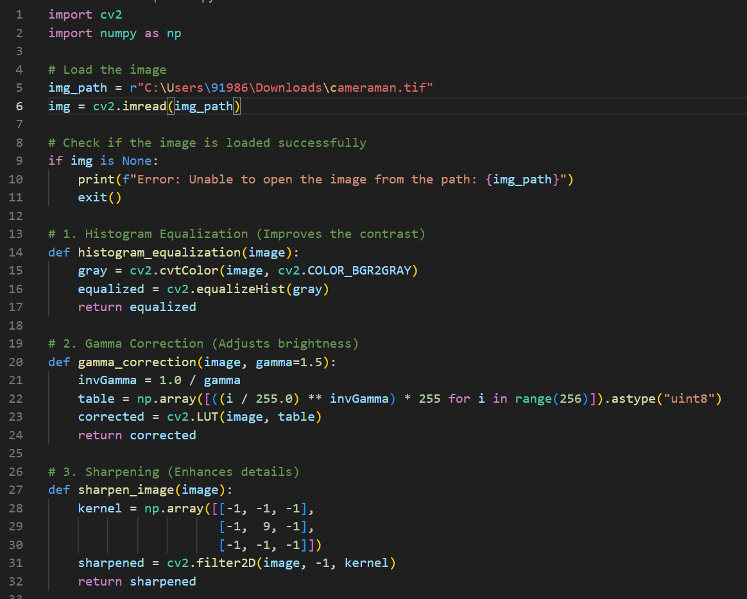
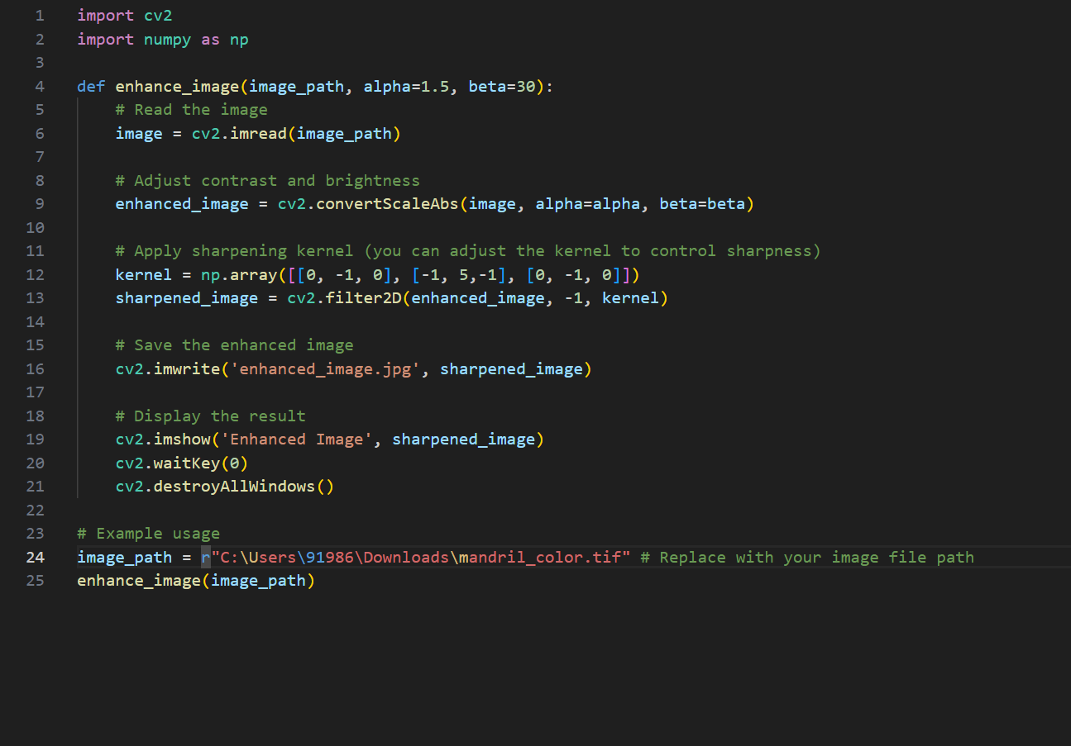
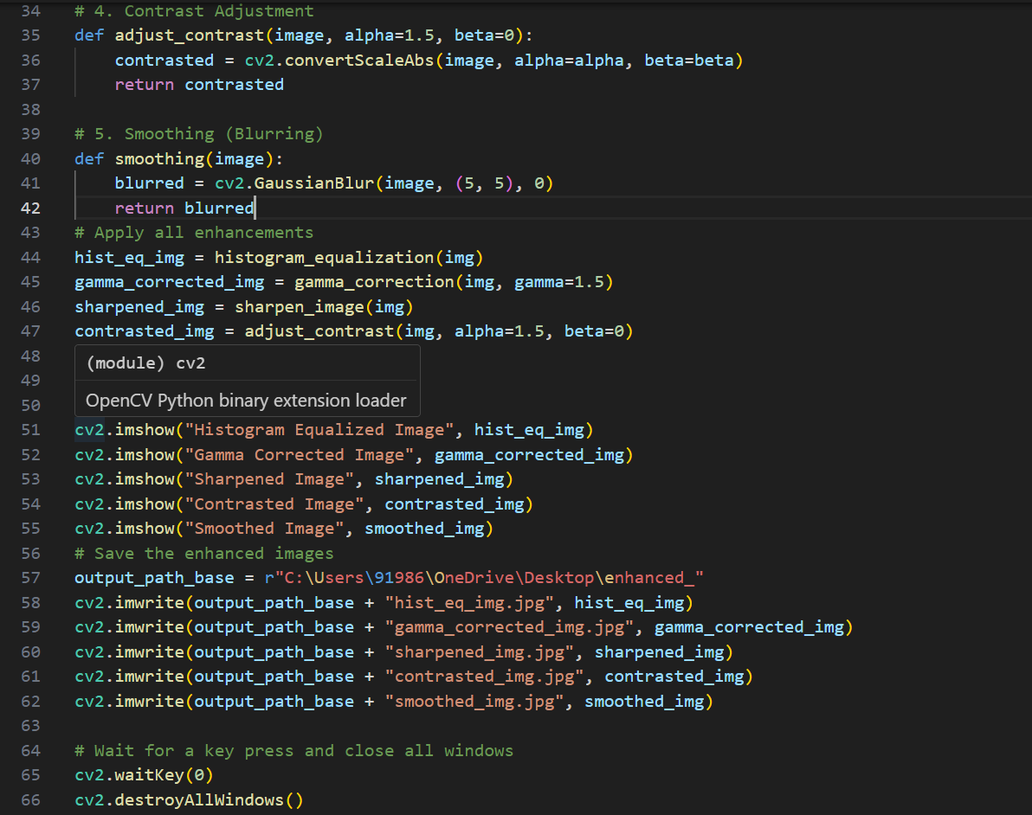
PROGRAM
IMAGE RESTORATION
IMAGE ENHANCEMENT

Slide 9
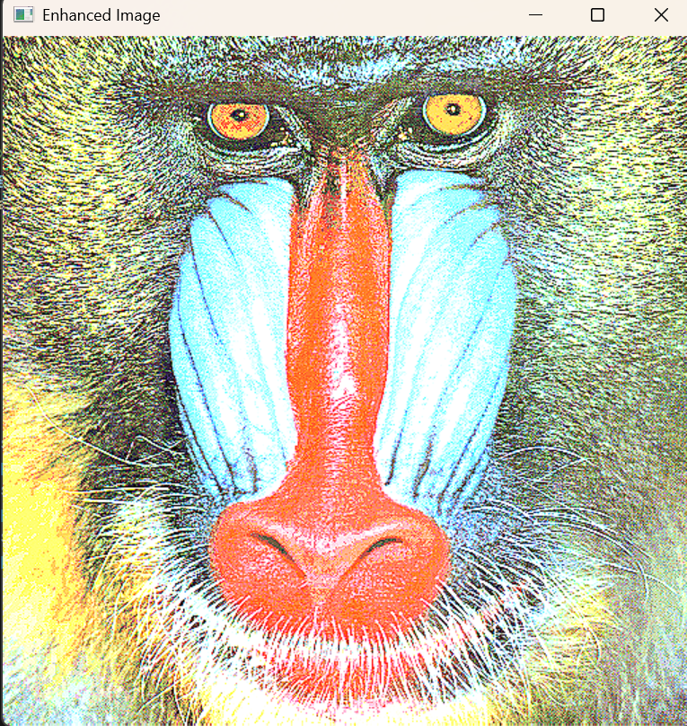
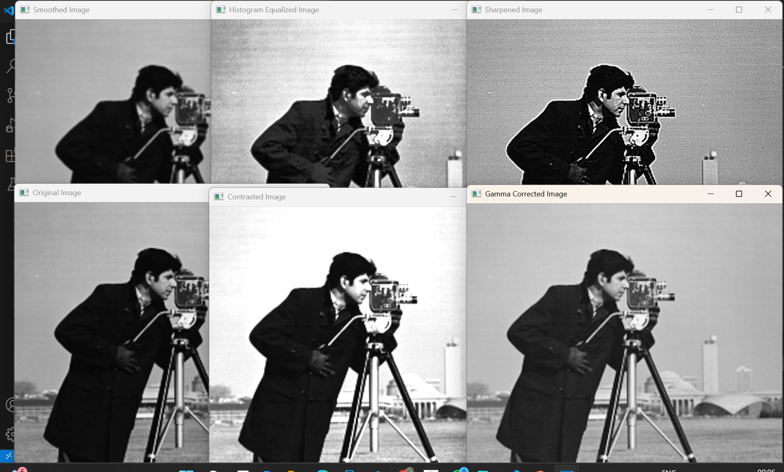
OUTPUT
IMAGE ENHANCEMENT
IMAGE RESTORATION

Slide 10
CONCLUSION
The image enhancement and restoration project aims to revolutionize image processing by integrating advanced tools and techniques to improve visual quality and recover degraded images efficiently. By addressing real-world challenges like noise reduction, blurriness, and data loss, the project showcases its significance across diverse domains such as healthcare, archaeology, law enforcement, and creative industries. With an emphasis on accessibility, practicality, and user-centric solutions, the project ensures broad appeal and impact, catering to professionals and everyday users alike. By preserving memories, enhancing visual experiences, and driving technological innovation, this project paves the way for transformative advancements that benefit both personal and professional landscapes.

Slide 11
GITHUB LINK
https://github.com/saibapireddypadala/IMAGE-RESTORATION-AND-IMAGE-ENHANCEMENT-USING-IMAGE-PROCESSING-TOOLS.git

Slide 12
FUTURE SCOPE
AI-Powered Advancements: With the growing adoption of artificial intelligence and machine learning, future tools can achieve even more precise and automated image enhancement and restoration, catering to specific user needs seamlessly.
Real-Time Processing: Enhanced algorithms and hardware acceleration will enable real-time enhancement and restoration, making these technologies faster and more efficient.
Integration in Emerging Technologies: These techniques can be integrated into augmented reality (AR) and virtual reality (VR) systems to improve visual experiences, benefiting gaming, education, and training applications.
Applications in Autonomous Systems: In industries like autonomous vehicles, enhanced image processing can improve the accuracy of object detection and navigation systems.
Personalized and Adaptive Systems: Future developments could include systems that adapt to user preferences, offering personalized image optimization for unique use cases.
Cross-Disciplinary Innovation: From restoring ancient artifacts to improving satellite imagery, the technology has the potential to contribute to fields like archaeology, space exploration, and climate monitoring

Slide 13
THANK YOU

